Slide 1
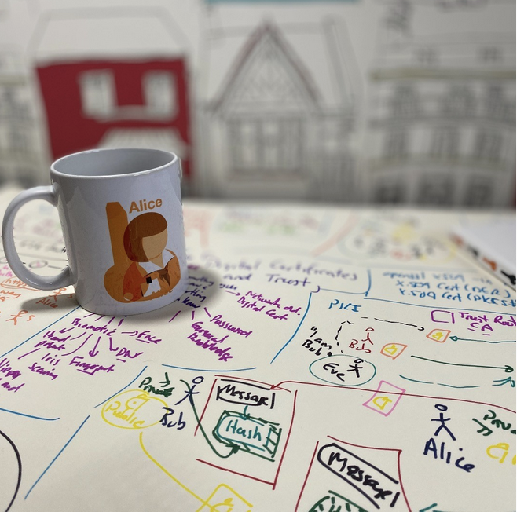
Tunnelling Basics. TLS. VPNs. Prof Bill Buchanan OBE https://asecuritysite.com/tunnelling

Slide 2
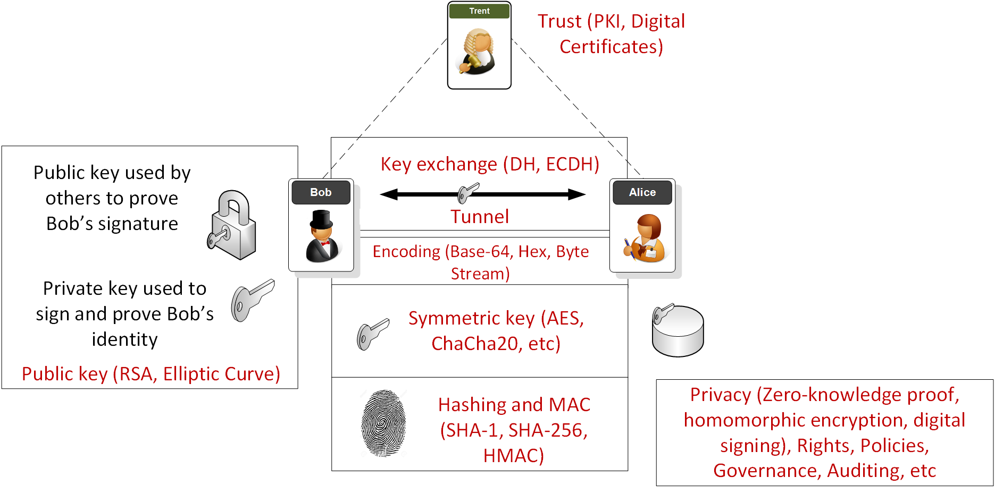
Overview

Slide 3
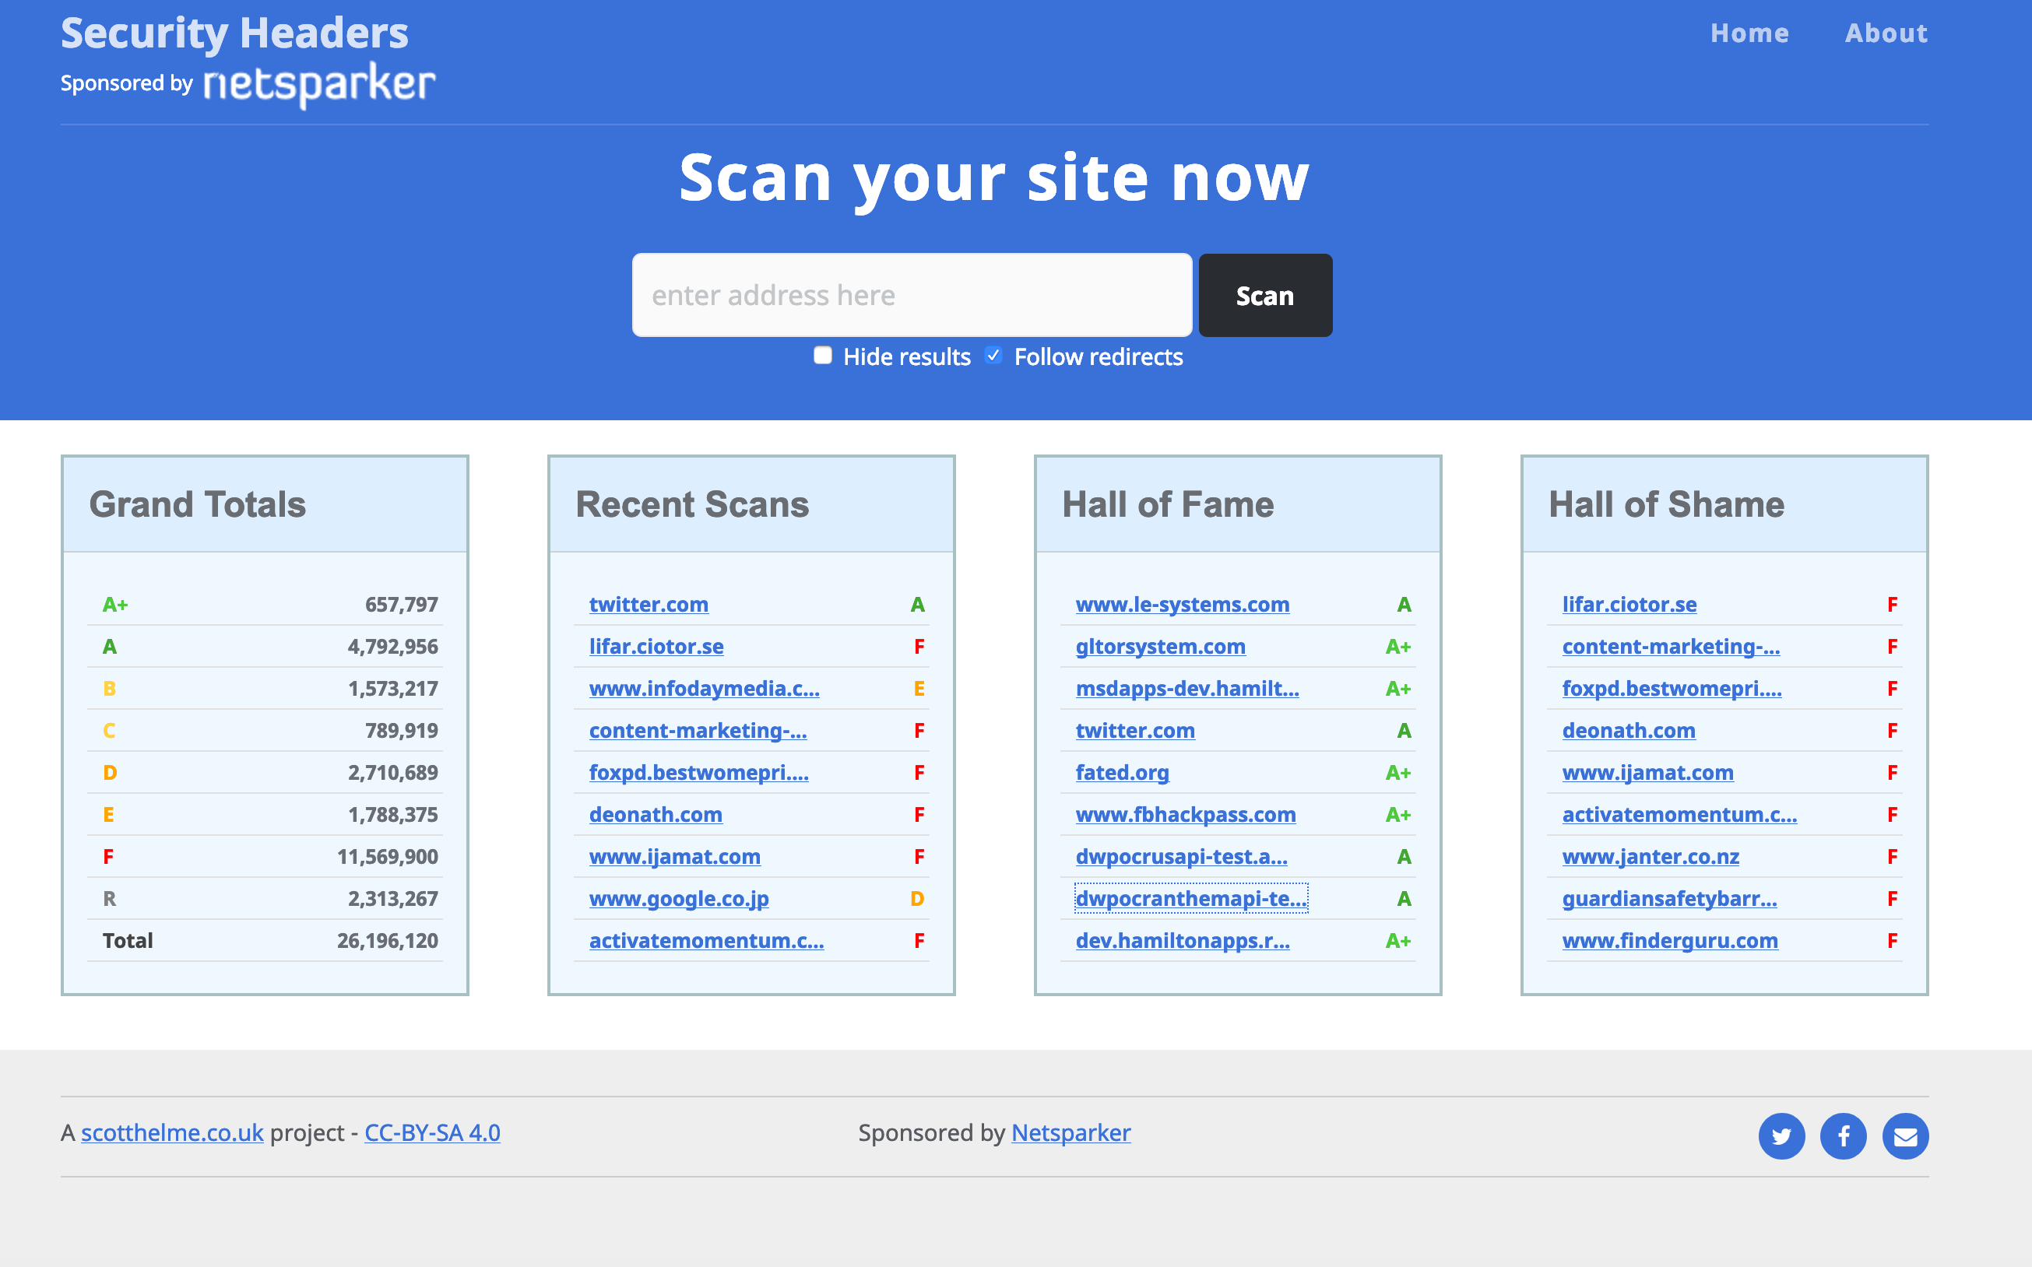
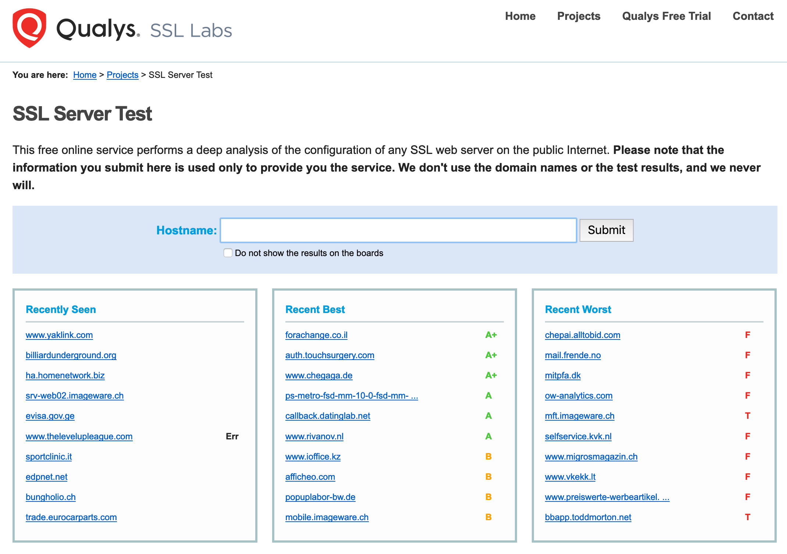

Slide 4
Tunnelling Basics. TLS. VPNs. Prof Bill Buchanan OBE https://asecuritysite.com/tunnelling

Slide 17
Tunnelling Basics. TLS. VPNs. Prof Bill Buchanan OBE https://asecuritysite.com/tunnelling

Slide 26
Tunnelling Basics. TLS. VPNs. Prof Bill Buchanan OBE https://asecuritysite.com/tunnelling

Slide 40
Tunnelling Basics. TLS. VPNs. Prof Bill Buchanan OBE https://asecuritysite.com/tunnelling

